Slide 1
Mission
Coretta Scott King Young Women’s Leadership
Academy is dedicated to developing leading ladies who strive for excellence in all endeavors.
Coretta Scott King YWLA
Vision
All CSKYWLA scholars will l become globally conscious college and career ready STEMinists
Key Performance Indicators
CCRPI – MS CCRPI – HS Overall CCRPI -
1
Maintain 100% Graduation Rate
Increase Milestone performance by 5%
Increase the number of students taking AP courses and passing courses with a 3 or more by 5%.
All students will maintain 90% course completion.
We are fostering academic excellence for all
2
  Develop a performing arts program to support the growth and development of performing arts talented learners.
2. Differentiate Instruction to meet specific learning needs of all students.
3. Incorporate technology in every classroom to support student learning needs through the Verizon Innovative Grant
4. Establish Graduation team to track and provided targeted support for each Cohort 2021/2022 senior.
5. Establish attendance committee led by the SSW to identify and support those students with an attendance rate below 80%.
13
We are building a culture of student support
3
We are equipping and empowering leaders and staff
50% of leadership team Trauma Informed certified
100% leadership team will be trained on Restorative Practice
Teachers will engage in weekly data driven PLCs designed to support explicit instruction, lesson internalization, and instructional best practices.
4
We are creating a school that supports all students
Atlanta Public Schools | 2020-2025 Strategic Plan

Slide 2
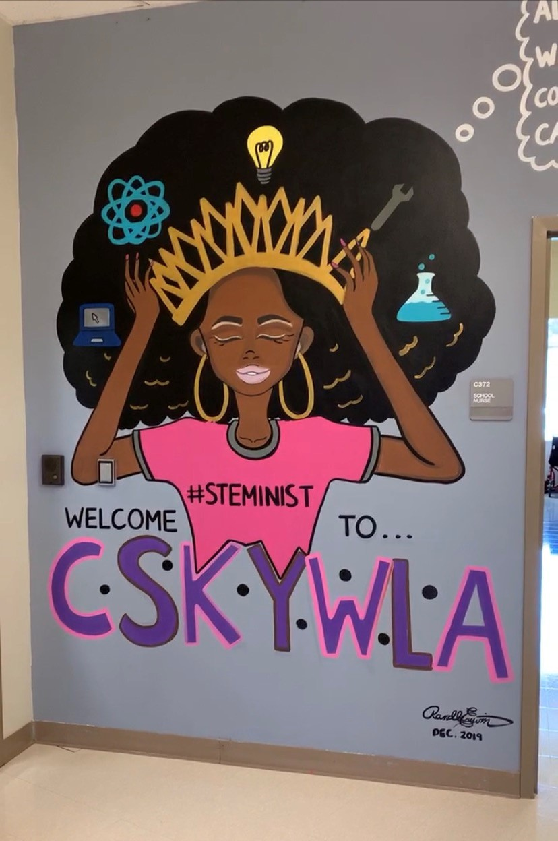
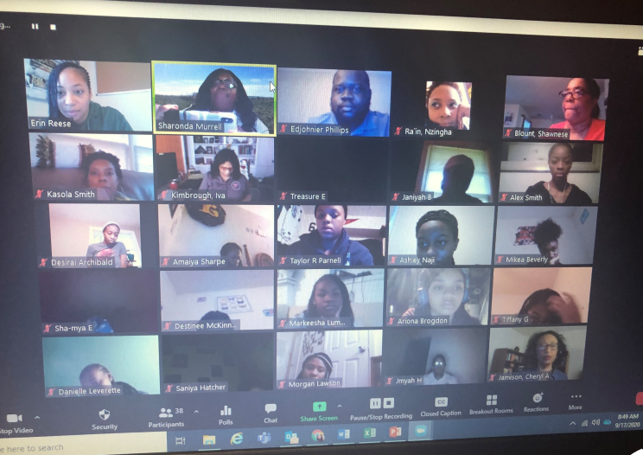
1 We are fostering academic excellence for all
2 We are building a
culture of student support
Increase Milestone performance by 5% in all core areas.
Maintain a 100% graduation rate.
90% course completion rate for all classes
Increase the number of classes available for MS students to receive HS credit
Expand the computer science program to include middle school scholars
School Priorities
Become a STEAM certified school
School Strategies
Insert School Strategies here
Continued
School Strategies
Implement the Amazon Engineering program to adopt the 6-8 curriculum for middle school computer science.
Atlanta Public Schools | 2020-2025 Strategic Plan

Slide 3
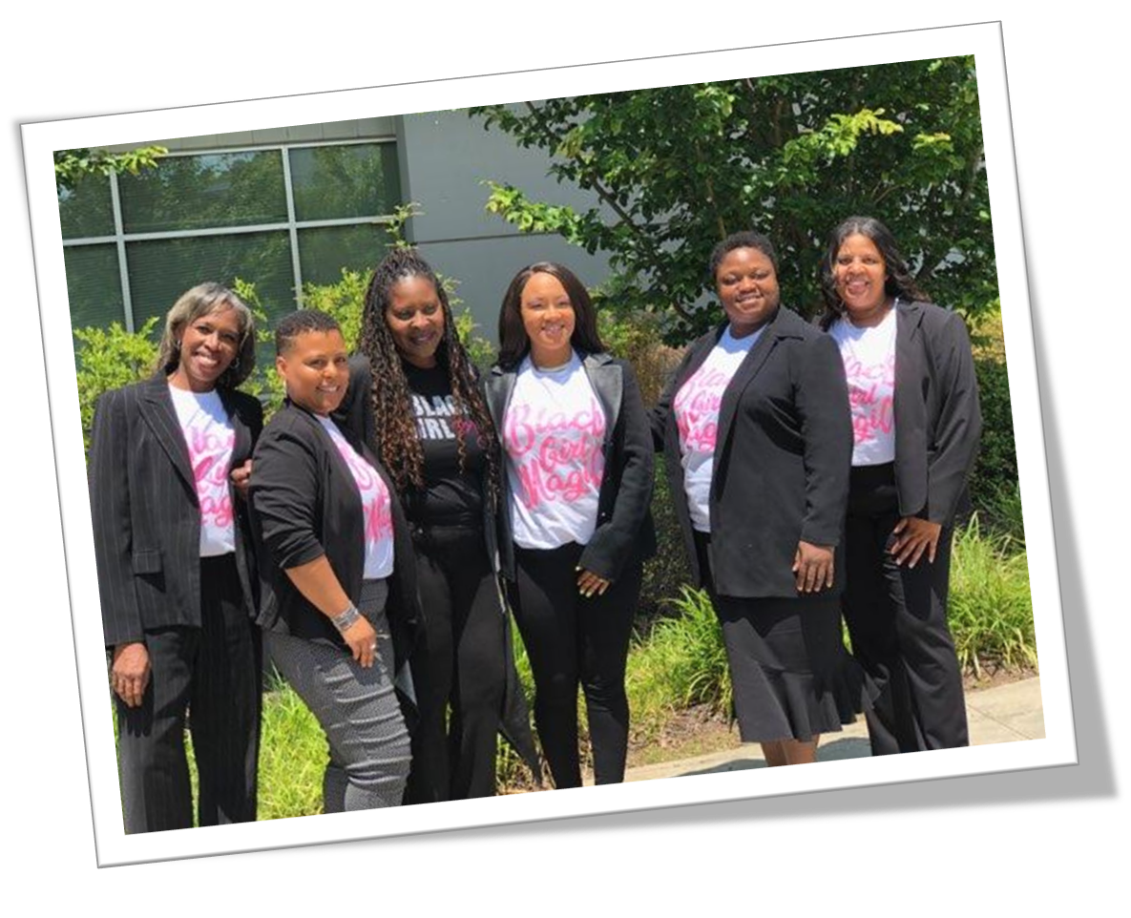
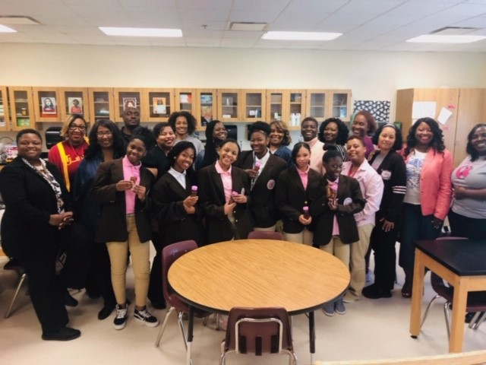
3 We are equipping and empowering leaders and staff
4 We are creating a school that supports all students
School Priorities
Implement a Horticulture pathway to support veterinary science and agricultural science.
School Priorities
Implement a Biliteracy Program to support the bi-lingual certification of graduating seniors.
School Strategies
Expand the world languages program to include Japanese.
Create a karate course in lieu of Physical education to embrace the Japanese culture.
Schedule all incoming 6th grades in 9-week connections world language course for exposure and interest (German, French, Spanish, Japanese)
Schedule eligible 7th graders in language of preference through 12th grade bilingual test preparation .
School Strategies
Partner with Gwinnett technical college for veterinary tech program
Expand the CSK vegetable garden through community outreach and partnerships.
Implement a Small animal care program to support a class pet in each classroom (middle School)
Partner with local veterinarians to support the care of animals in the veterinary science program.

Slide 4


All CSKYWLA Scholars will be Globally Conscious College and Career Ready STEAMinists
4
Notes:
Travis- keep moving forward…

Slide 5
Mission
Garden Hills Elementary School will develop inquiring, knowledgeable and caring young people who are well informed and respectful of others .
Garden Hills Elementary School
Vision
To be a leading provider of the Primary Years Programme,
preparing students for the intellectual challenges of further
education, focusing on the development of the whole child as
an inquirer, both in the classroom and in the world outside.
Key Performance Indicators
Reading Growth (All Student, EIP, ESOL)
1
Offer students relevant instruction that supports comprehension and communication in all core content areas.
Provide support services to targeted groups of students based on needs through transdisciplinary model
We are fostering academic excellence for all
2
Extend focus on bi-literacy through implementation of dual language and oral proficiency based Spanish World Languages program
13
We are building a culture of student support
3
We are equipping and empowering leaders and staff
Build teacher capacity to reach all learners in their classrooms
Expand teacher and school collaboration opportunities
Intentionally recruit high-quality bi-literate teacher candidates
Inform and engage the school community
Foster a positive, informed and engaged school culture
4
We are creating a school that supports all students
Build systems and resources to support Cluster Plan to include IB implementation
Atlanta Public Schools | 2020-2025 Strategic Plan

Slide 6
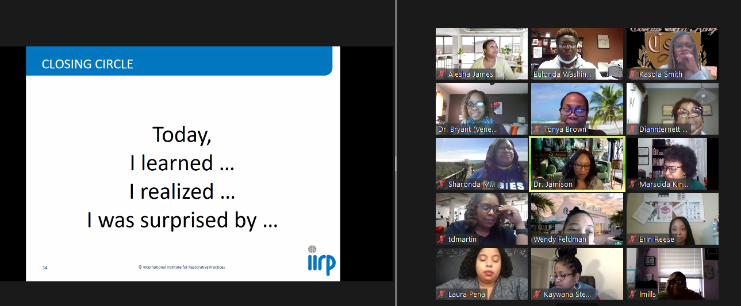
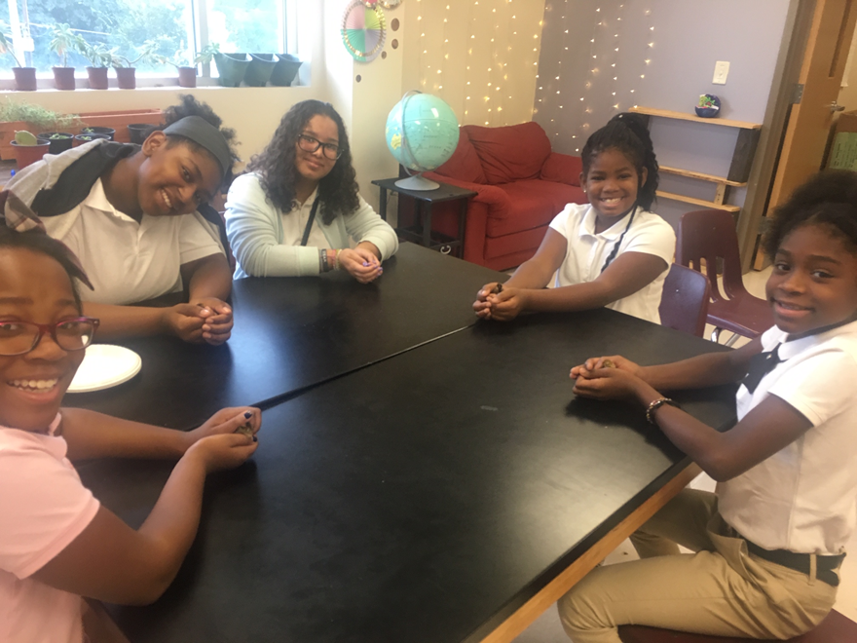
STRATEGY
1 We are fostering academic excellence for all
2 We are building a
culture of student support
School Priorities
Provide targeted support as an intervention for struggling learners in reading and mathematics.
Provide support services to target struggling learners
School Priorities
Extend focus on bi-literacy through implementation of dual language and oral proficiency based Spanish World Languages program
School Strategies
Implement math/reading support classes for 100% of students performing at a beginning level in math and/or reading.
Focus on individual student goals through the use of data for targeted support.
Increase the number of middle school course offerings for high school credit.
Ensure teachers have access to instructional resources that support remediation and acceleration.. IXL, Flocabulary, Reading PLUS, Nearpod.
Identify strategies to gauge learning loss resulting from virtual learning due to COVID-19. Provide before and afterschool opportunities for recovery: After school All-stars, after-school tutorial, and Saturday school.
Develop IB “Planners” and the Example School Programme of Inquiry
Implement IB Learner Profile and Attitudes school-wide
Ensure units of Inquiry integrate content and project-based learning
School Strategies
Enhance student engagement & achievement in Spanish classes through reflective practices using the TELL Framework

Slide 7
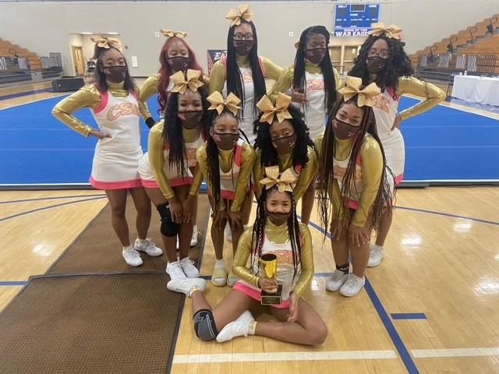
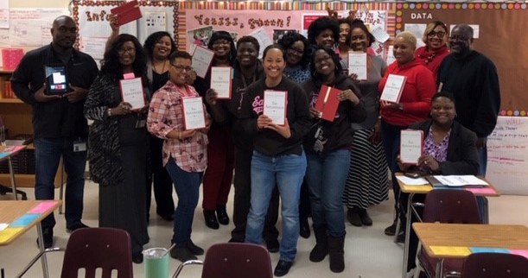
3 We are equipping and empowering leaders and staff
4 We are creating a school that supports all students
School Priorities
Build teacher capacity to reach all learners in their classrooms
Expand teacher and school collaboration opportunities
Intentionally recruit high-quality bi-literate teacher candidates
Inform and engage the school community
Foster a positive, informed and engaged school culture
School Priorities
Build systems and resources to support Cluster Plan to include IB implementation
School Strategies
Provide targeted professional learning for all teachers to improve early literacy instruction and assessment for remediation
Provide targeted professional learning for all teachers to develop and implement the International Baccalaureate PYP and implement the APS Instructional Strategies
Ensure certify staff obtain gifted endorsements
Extend partnership with AIS to include PL for staff at both schools
Intentionally plan & implement PLCs based on needs
Participate in collaboration with Georgia State to recruit bilingual candidates for internship
Build community awareness, knowledge and support for IB PYP
Implement student attendance initiatives
Communicate academic growth/progress to parents of Gr 2-5 students at mid year and End of year intervals
Implement Social and Emotional Learning (SEL) for school staff
Enhance internal communication
Provide translation and support services for ESOL families and students
Establish and implement teacher-teacher recognition to build peer recognition of accomplishments
School Strategies
Cultivate Business and Community Partnerships to support IB Implementation and Supplemental Training
Carefully document and track IB Teacher Training, IB Planner Development, IB Programme of Inquiry Development

